Slide 1
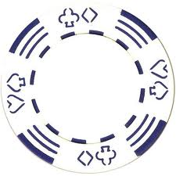

Terrapinn GES summit
User case and product requirements
Ollie B

Slide 2


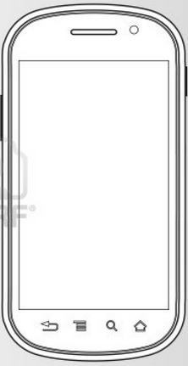
2.
User is now logged in and through filters selects who they want to network with
1.
Attendee card that has been programmed with profile information based on online LinkedIn authorization is tapped at networking station
Hi Ollie Bath
You have 2networking tokens remaining
Select who you’d like to chat to
Name
Company
Title
3.
Skills
User hits the “speak to Pete” button when person is selected. A SMS is then sent to that user.
ID: 123
Speak to Pete
From: CloudTags(Ollie)
CloudTags
From: CloudTags(Pete)
“ You just won a chip off Ollie! He’s the Head of UK operations at Cloudtags UK and would like to meet up. You game? If so respond to this message
“ Hi Ollie, thanks for getting in contact. Meet at table 5 at networking area at 1pm? “
4.
Now users can blindly communicate via text message facilitated by CloudTags text messaging service

Slide 3
Background Information
World gaming summit being held in Barcelona 9th-11th July 2013
300 delegates
CT to provide event networking solution
Goal: Increase delegate networking
Solution: Gamify networking by having a the currency of networking chips. Attendees can hedge their bets on a meeting with other attendees by using their limited virtual networking chips associated with their profile. Meetings are setup by tapping NFC tablets located in the networking area of the event. Communication will take place via blind text messaging facilitated by CloudTags.

Slide 4
Email opt-in and account creation
Terrapinn send all delegates an ‘event networking’ email two weeks prior to event informing them of the amazing, exciting networking “game” they’ll have at the summit.
In order to participate in summit networking delegate click on a link in the email and is directed to a CT/Terrapinn mobile optimized web page and asked to do three things:
Opt in (terms and conditions)
Enter their mobile number (it’s explained why they need to do this)
Connect their linked-in profile
If user opt-in and connects LI and submits mobile number we send confirmation email “congrats you have 3 networking chips”
Prior to the event each profile will be associated with a NFC card
With what is the NFC card encode with? Web URL / unique ID?

Slide 5
Event registration
User arrives at event registration to collect pre-programmed and printed NFC card
They present their QR code / proof of ID that Terrapinn sent them
Registration personal hand associated card to attendee and reminds them of the networking credits/chips
Attendee enter summit

Slide 6
The summit environment
There will one speaking theatre
Multiple ‘networking areas’ which include place for attendees to sit down
In this area we’ll have 10 tablets that users will use to start their networking experience
One large ‘leader board’ screen that will show chips per person – Emulating poker players around a poker table

Slide 7
What happens when I tap a networking station (NFC tablet)
My profile is is pulled up at the top of the screen ‘ Hello Ollie’ showing I have three chips:
I can see a list of all event attendees who have opted in to network
I can FILTER results by; company, title, expertise, name. NOT search functionality.
I select the person I’d like to converse with form the list and a text message is then sent to that person that says “ You just won a chip off Ollie! He’s the Head of UK operations at Cloudtags UK and would like to meet up. You game? If so respond to this message”
Conversation is kicked off this and the exchange of networking chip occur this way.
Attendees can not contact same person more than once.

Slide 8
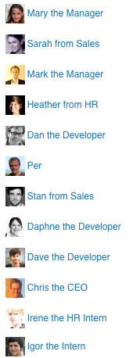
Leaderboard
Public leaderboard showing number of chips won (meetings requested)

Slide 9
LinkedIn
Authorizing CloudTags to access basic LinkedIn data to build out users summit public summit profile:
Profile pic
Name
Company
Title
Summary
Top rated skill
With little effort what else could we do with LinkedIn user data?

Slide 10
Email registration considerations
User doesn’t have LinkedIn
User manually creates profile via a form
User doesn’t share mobile phone number
We use existing Terrapinn CRM data to create profiles – Feed can be provided be Terrapin

Slide 11
Post summit considerations
Who owns the profiles?
Can we integrate this into Terrapinn CRM or Event Genie?
How do attendees continue to network though the application post event?

